Slide 1

Optimization Algorithms
RMSprop
deeplearning.ai

Slide 2
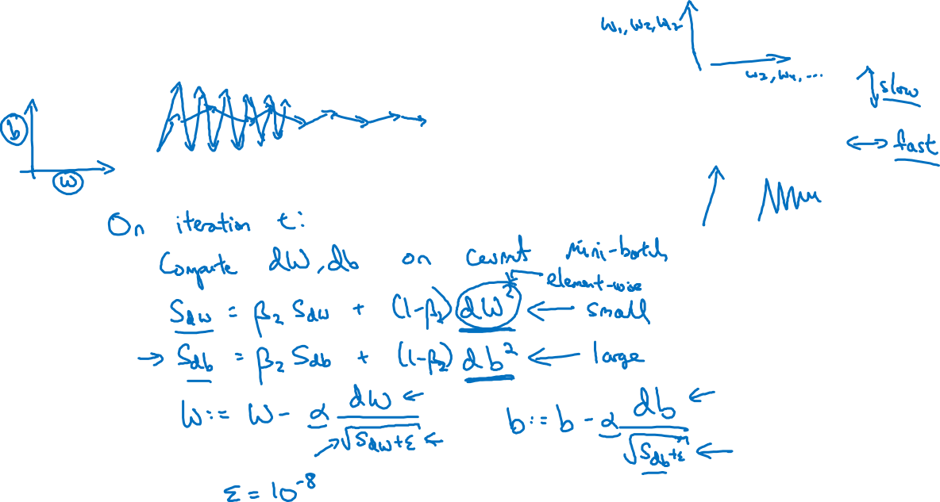
RMSprop

